Slide 1
Detect Asia sample size simulation

Slide 2
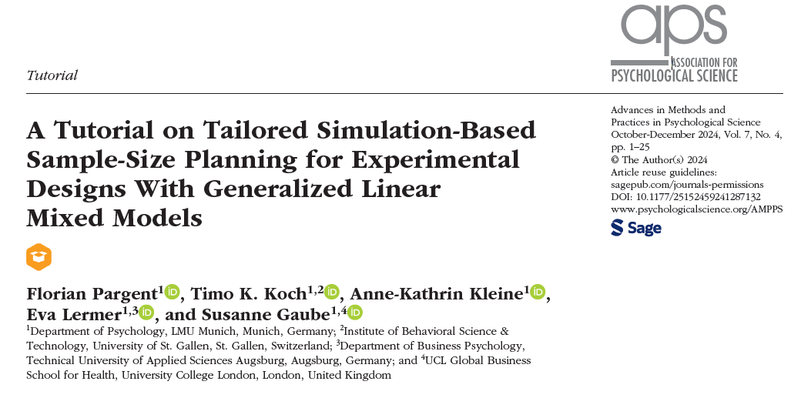

Slide 3
Trial setting up
Study sites: 6 intervention + 2 control (random?)
Data collection: x samples from each site each month
Time points: 12 months pre-intervention + 12 moths post-intervention
Outcome: time to positive culture (Assume 100% sensitivity? Gold standard? Distribution? )
Random effect: within site, 0.3-0.6 autocorrelation
Effect size: 20%-30% reduction (-0.3 log scale) (reduction in mean or median? What is baseline value?)

Slide 4
Simulation steps
1. Define the estimand: detection time deduction
2. Data simulation
3. Population parameters
4. Estimate the statistical model
5. Compute the estimate
6. Repeated simulations
7. Sensitivity analysis

Slide 5

2. Data simulation
Site: 1-8
Month: 1-24
Post: 1 (month > 12), 0 (month < 13)
Sample: 1-X
Data row = 8*24*X
Intervention: T/C
ToD: t0 + β1*month + β2*Intervention*post + random(site) + random error

Slide 6
3. Population parameters
What is t0 distribution?
β1
β2: -0.3 (log scale)
Site-specific random effect (AR1 0.3-0.5)
Random error

Slide 7
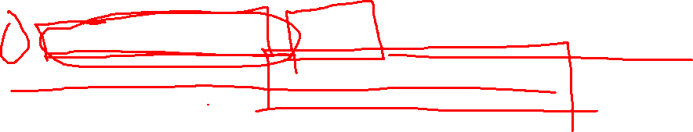
4. Estimate the statistical model
lme(y ~ intervention*post + month, random = ~1|site-month, data = dat, correlation = corAR1(form = ~1|site-month))
lme(y ~ intervention*post + month, random = ~1|site-month, data = dat, correlation = corAR1(form = ~1|site))

Slide 8
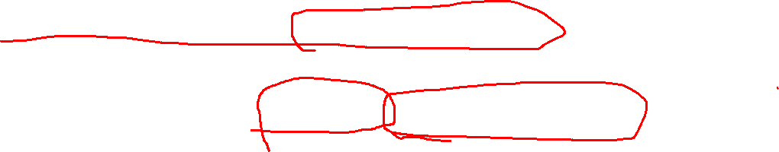
Simulation steps
1. Define the estimand: detection time deduction
2. Data simulation
3. Population parameters
4. Estimate the statistical model
5. Compute the estimate: hypothesis testing
6. Repeated simulations: 1000 iterations
7. Sensitivity analysis: null effect, varying parameters

Slide 9


